Slide 1
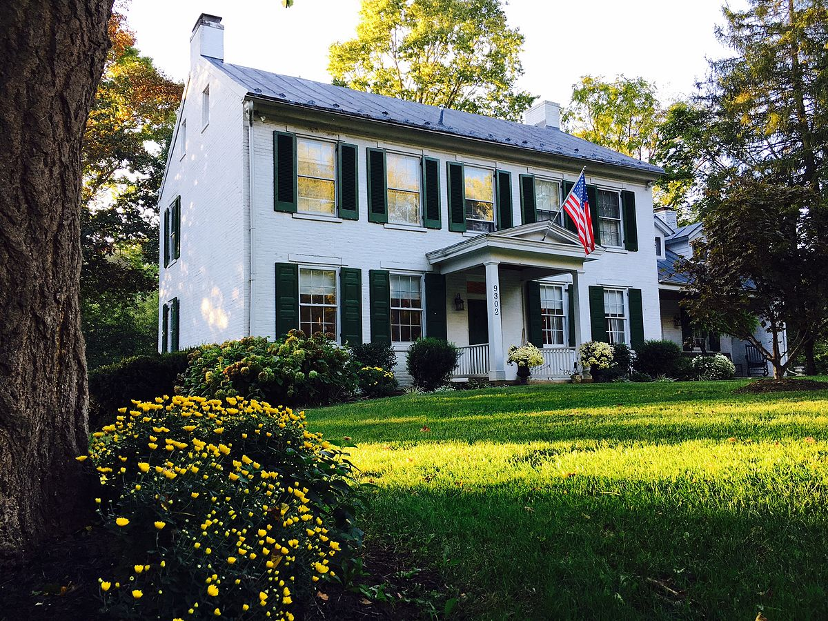
Investing in Real Estate: Ames, IA
Uncovering Undervalued Properties
to Maximize Profitability

Slide 2

Revenue has been lagging due to lower margins and increased mispricing of properties, which has delayed sales and bloated the Ames residential portfolio, tying up capital that could have been invested in more lucrative properties.
!
Lower than expected margins have weighed down revenue due to fewer properties sold at above-average valuations
A new model is needed to find undervalued properties with high-profit potential.
!
Fewer properties have sold at projected valuations due to repeated mispricing by the current
valuation model
A new valuation model is needed to identify factors that move the market and better forecast sales price.
Source: https://www.kaggle.com/pmarcelino/comprehensive-data-exploration-with-python#Out-liars! (accessed 2/24/2020)

Slide 3
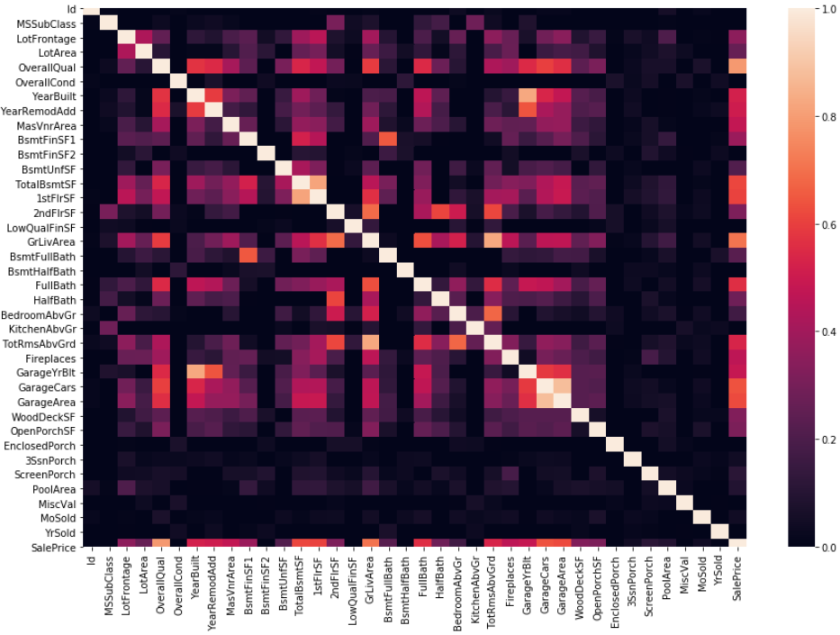
Homes with the highest profit potential are undervalued. Eight key factors correlated with home valuation were identified, then used to determine market value and find undervalued homes.
Key Insights
■ Data were reviewed for 1,460 properties in 25 neighborhoods in Ames, IA.
■ Homes with highest profit potential have/are:
■ Overall quality score > 6 ■ At least 2 full baths
■ Great living area > 1,200 sq. ft. ■ Garage space for at least 2 cars
■ Basement size > 700 sq. ft. ■ Typically no more than 35 years old (i.e., built after 1984)
■ More than 6 rooms above ground ■ Located in the most undervalued neighborhoods
Source: https://www.kaggle.com/pmarcelino/comprehensive-data-exploration-with-python#Out-liars! (accessed 2/24/2020)

Slide 4
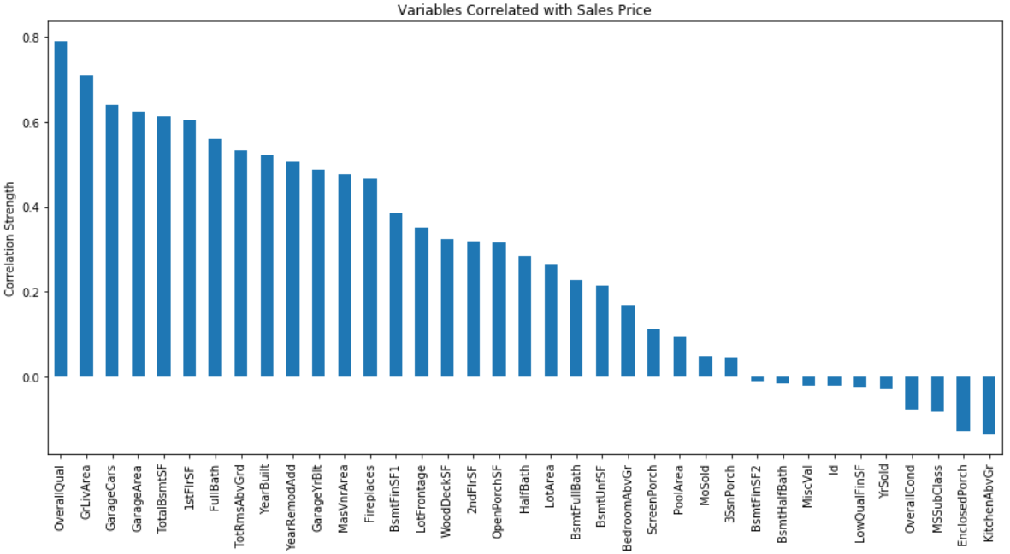
Statistical analyses
DESCRIPTIVE STATISTICAL APPROACH
INFERENTIAL STATISTICAL APPROACH
Source: https://www.kaggle.com/pmarcelino/comprehensive-data-exploration-with-python#Out-liars! (accessed 2/24/2020)

Slide 5
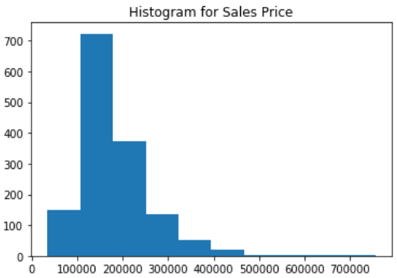
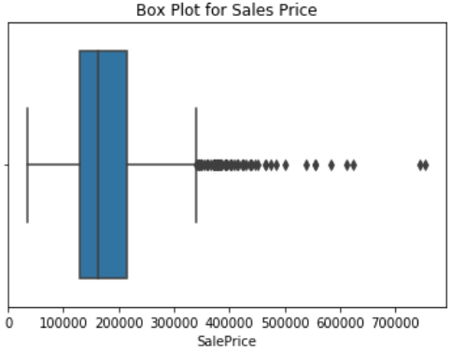
Descriptive statistical analysis identified positive skew in sales price data, as well as outliers and missing data in the dataset, which were excluded from the regression analyses.
Key Insights
The proportion of outliers in the dataset is 38.6%.
Outliers were removed from variables used in the regression analyses.
Variables with missing data were excluded from the regression analyses.
Source: https://www.kaggle.com/pmarcelino/comprehensive-data-exploration-with-python#Out-liars! (accessed 2/24/2020)

Slide 6
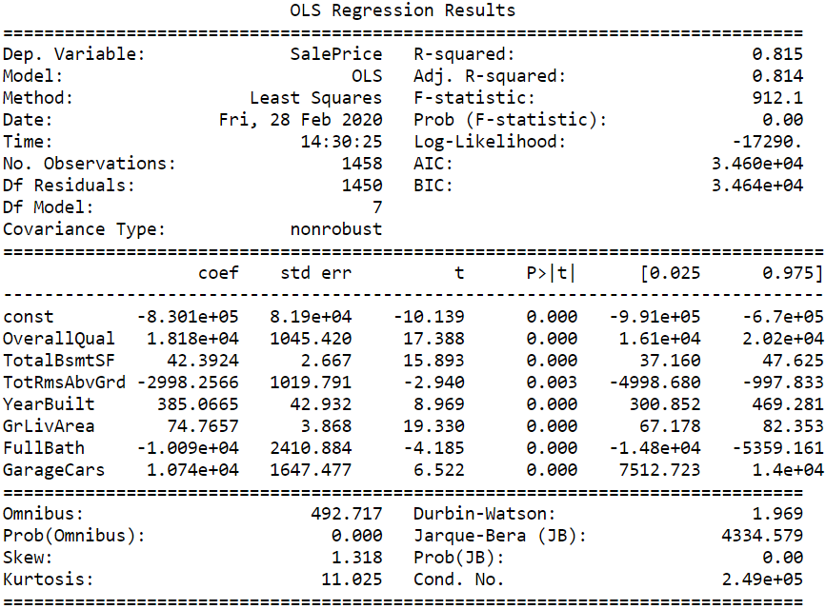
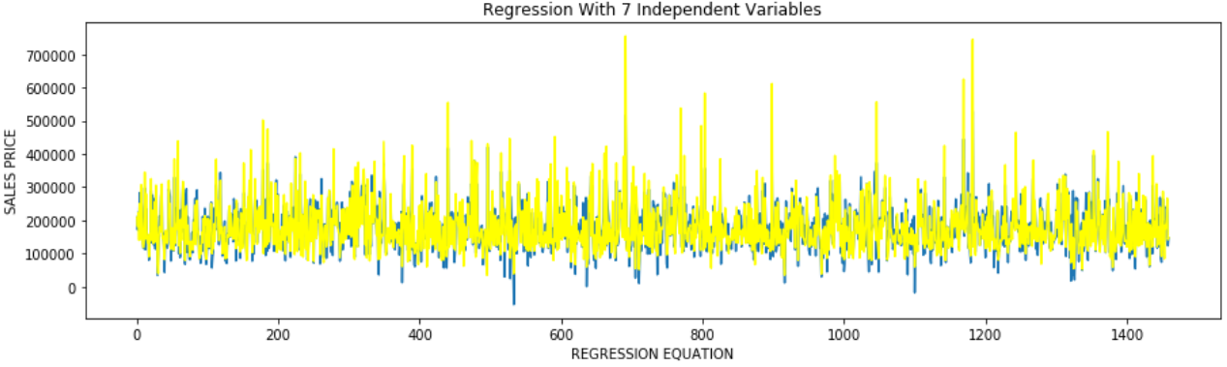
Inferential statistical analysis identified 7 variables correlated with home valuation with an adjusted R square of 0.81: overall quality score, great living area (sq. ft.), basement size (sq. ft.), rooms above ground, garage capacity, full baths, and year built.
Key Insights
R-squared values were much lower for each variable when compared separately to home sales price:
0.63 for overall quality ■ 0.31 for full baths
0.54 for great living area ■ 0.29 for rooms above ground
0.41 for garage cars ■ 0.27 for year built
0.38 for basement sq. ft.
Source: https://www.kaggle.com/pmarcelino/comprehensive-data-exploration-with-python#Out-liars! (accessed 2/24/2020)

Slide 7
Investing in Real Estate: Ames, IA
Thank you!

